Slide 1
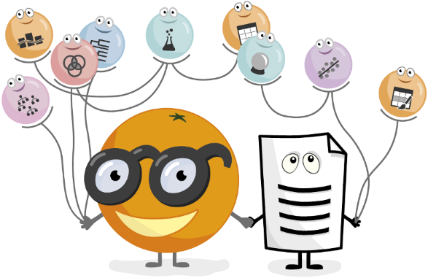

Presented by : Jurgen Xhafaj & Pedro Romero

Slide 2
What is Orange?
Orange is a Python-based tool for DM being developed at the Bioinformatics Laboratory of the Faculty of Computer and Information Science at the University of Ljubljana.
According to their website (https://orange.biolab.si/), orange offers:
Open source machine learning and data visualization for novice and expert.
Interactive data analysis workflows with a large toolbox.
Orange is compatible with Windows, macOS, and Linux/Source operating systems.
To install, type “pip install orange3” in Anaconda Prompt.

Slide 3
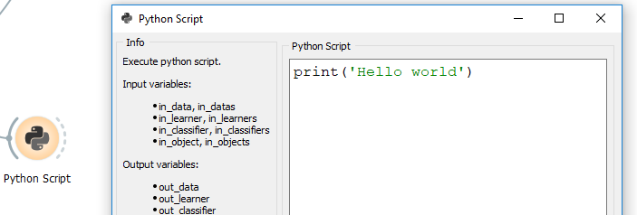
How is Orange used
Through Python scripting
As a Python plug-in
Through visual programming
Note: One apparent downside of Orange is that the number of available widgets seems limited when compared to other tools such as RapidMiner or KNIME, especially because of the lack of integration with Weka.

Slide 4
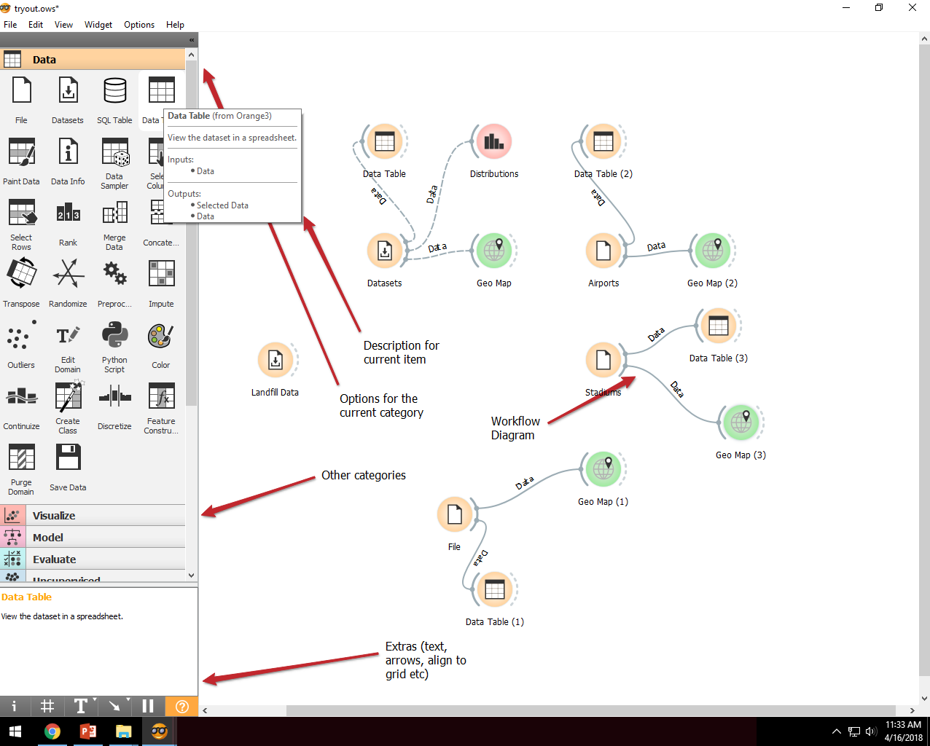
GUI (Orange-Canvas)

Slide 5
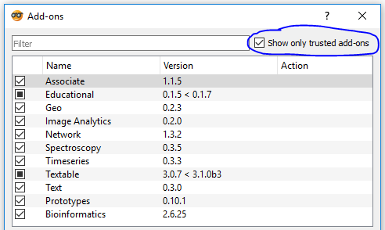
Optional packages
Orange comes with 4-5 main packages, but you can do much more once you install other packages.
Go to Options-> Add-ons and select the packages.
P.S. You can find more add-ons by unchecking the box “Show only trusted add-ons”.

Slide 6
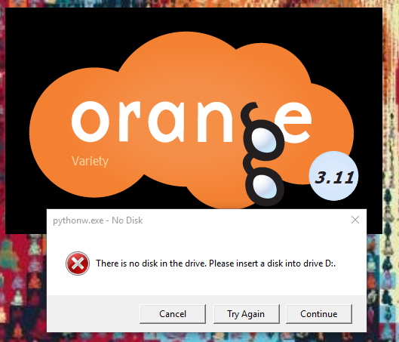
WARNING
Before installing a package, save all your data and (preferably) restart Orange.
Install the packages one by one.
After an add-on has been installed,
make sure to restart Orange.
***I tried to install two packages in a row (without restarting) and this happens every time now. (In which case, click Cancel twice to save yourself from the pain.)

Slide 7
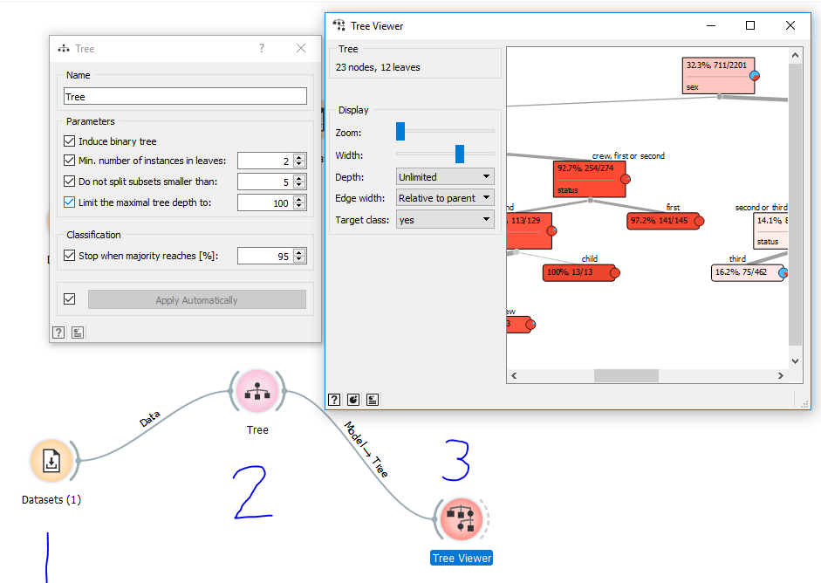
Visualizing a Decision Tree

Slide 8
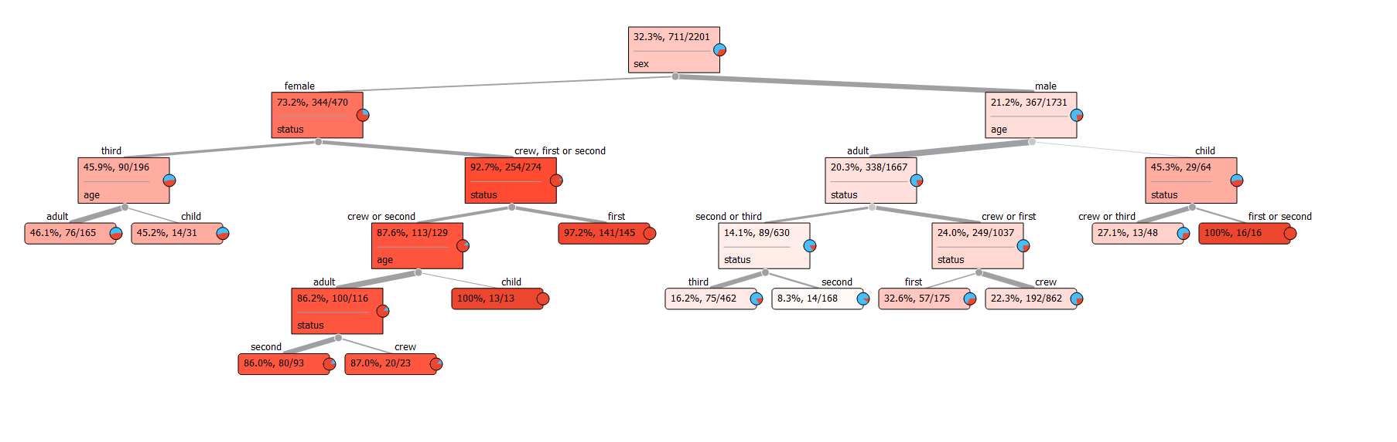

Slide 9
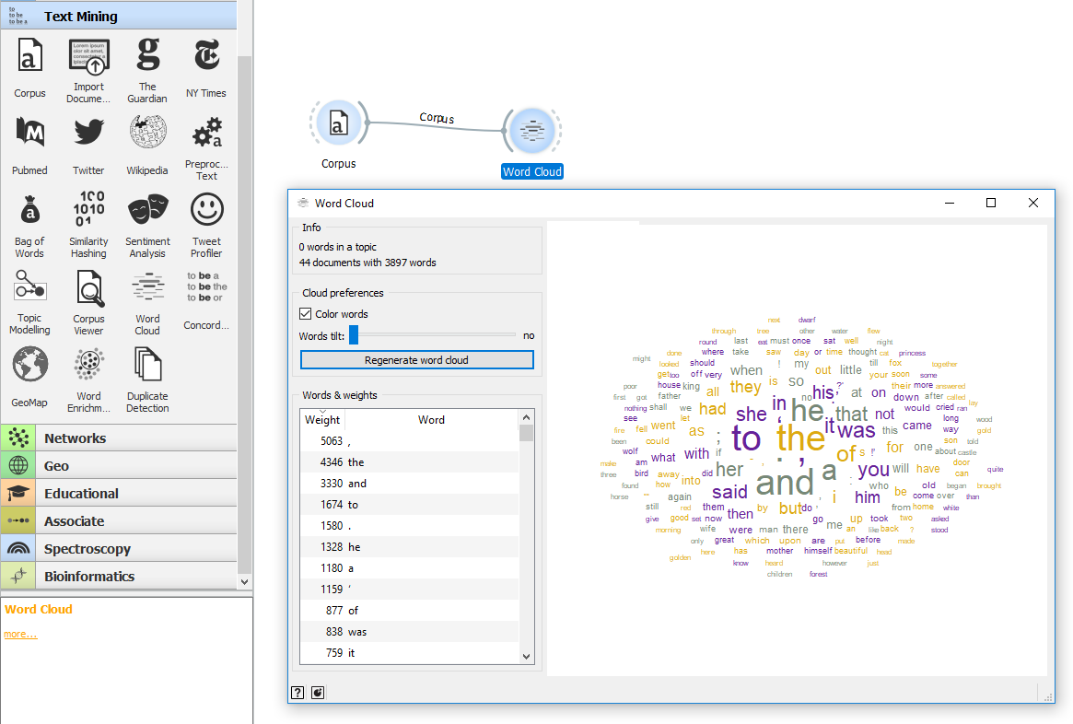
Word Cloud feature

Slide 10
Demonstration of Orange functions

Slide 11
Advantages of using Orange
The GUI is pretty easy to use
There are a lot of options for manipulation and visualization
You can do flowcharts and diagrams
It has plenty of examples and tutorials to get you started
Visualization windows can be accessed at the same time as the main window
It keeps implementing new features (included in “Prototypes” category)
Orange tends to understand the input data rather well, and that helps a lot with the visualization part.
You can connect a lot of parts together and work with them at the same time.
It has ANN based clustering, k-means clustering, kNN instance based learning
It has several evaluation methods and metrics.
https://pdfs.semanticscholar.org/65fd/dc055a2b7511f7c9a5a1eead16defa9e7390.pdf

Slide 12
Disadvantages of using Orange
The community support level is moderate (as compared to large community support in R)
It can not import Excel .xlsx files
Does not have random projections (like R does)
Does not have hybrid learning methods (logistic model trees, function trees, Bayesian trees)
It does NOT have 3D Graphs
It does not have specialized data mining tasks like deep learning, big data, time-series, or data streams (though it does have some text mining features).
https://pdfs.semanticscholar.org/65fd/dc055a2b7511f7c9a5a1eead16defa9e7390.pdf

Slide 13
THANKS FOR WATCHING!

